Slide 1
CSS Positioning
- Raviraj Shinde

Slide 2
Index
Introduction to CSS Positioning
Positions
  position: static
  position: relative
  position: absolute
  position: fixed
  Position: sticky
z-index

Slide 3
1. Introduction to CSS Positioning
Determines how elements are placed in the layout
Overrides normal document flow
Helps in building flexible & precise UI
Works with offset-properties:
  top, left, right, bottom, z-index
document flow: natural way HTML elements appear on the page
- without any special positioning

Slide 4
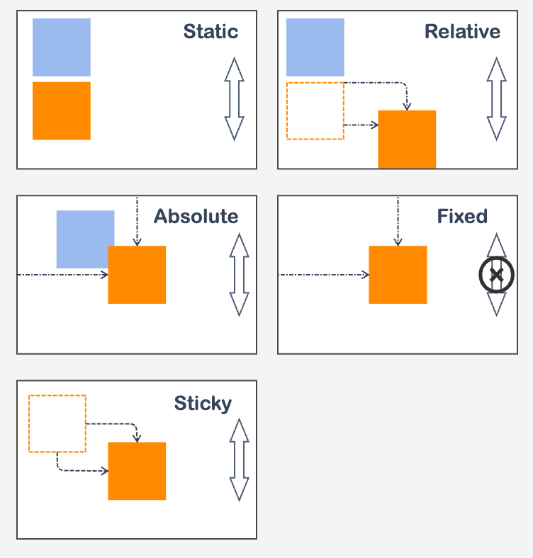
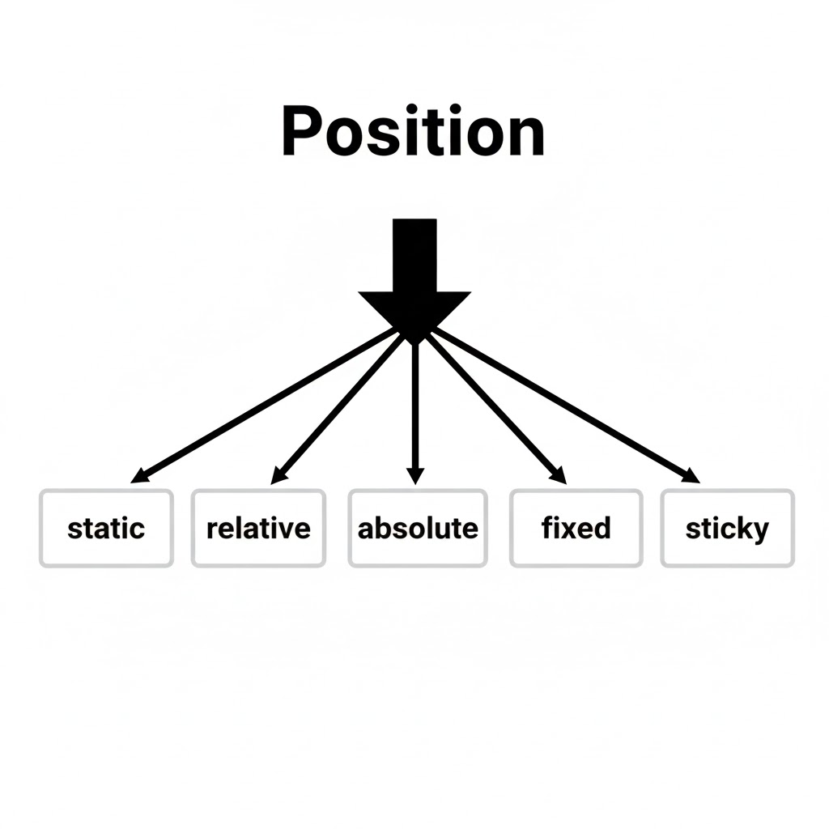
2. Positions

Slide 5
2. position: static
Default positioning
Element follows normal flow
Top, left, right, bottom do not ❌ work

Slide 6
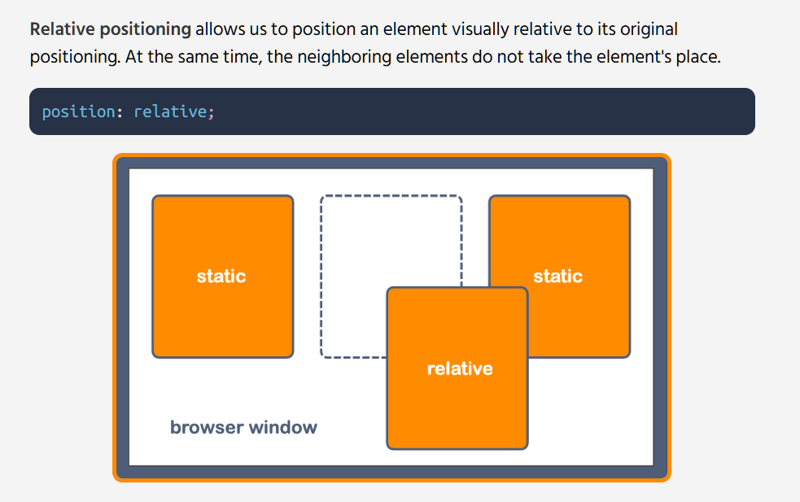
2. position: relative

Slide 7
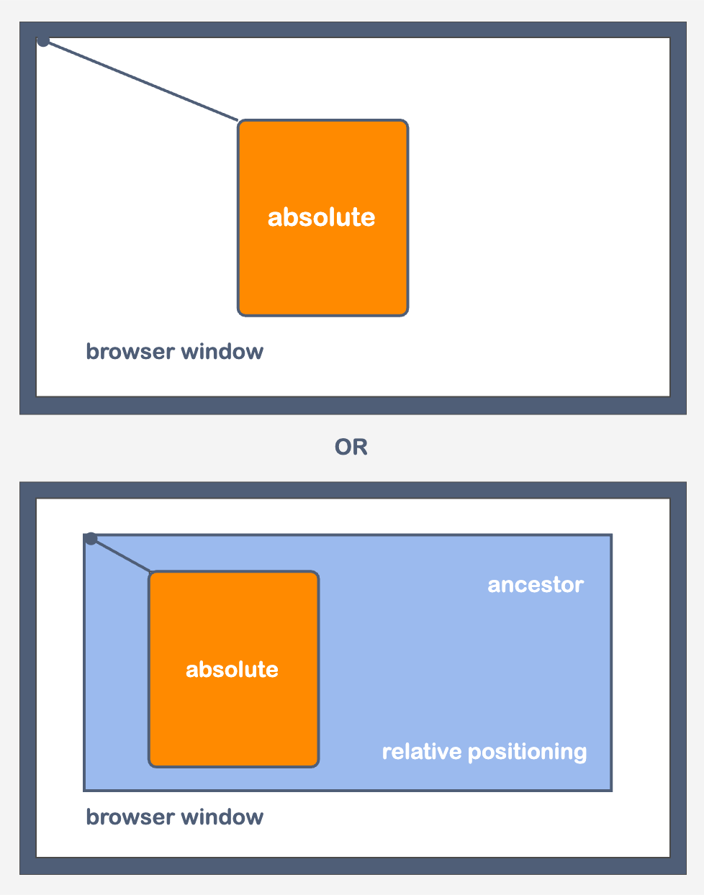
2. position: absolute
Removed from normal document flow
(Space ❌)
Positioned relative to nearest positioned parent
Uses top/left/right/bottom for exact placement

Slide 8
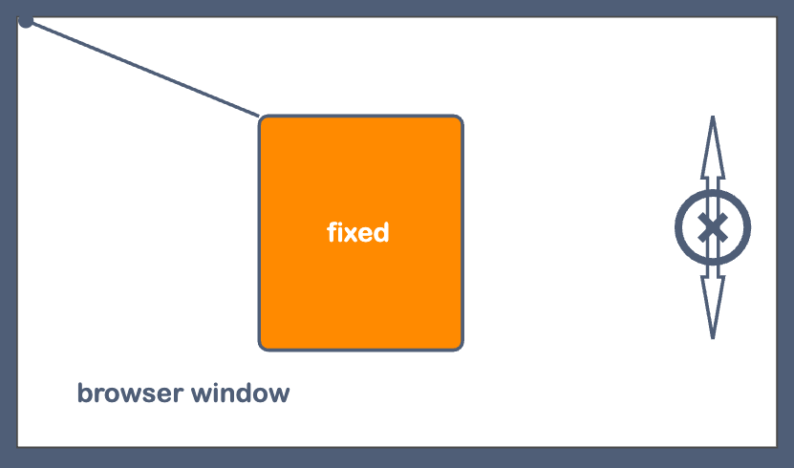
2. position: fixed
Stays fixed relative to the viewport (screen)
Does not move when the page scrolls
Removed from normal document flow (Space ❌)
Ideal for navbars, floating buttons, chat icons

Slide 9
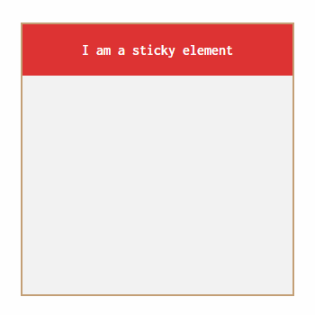
2. position: sticky
Becomes fixed inside its scroll container
Acts like relative until a scroll threshold
Depends on top/bottom etc. values to stick.

Slide 10
3. z-index
Controls which element appears on top
Overrides Higher number = comes above lower number
Works only on positioned elements (relative, absolute, fixed, sticky)
Helps fix overlap issues in UI

Slide 11
THANK YOU!

